Slide 1
Dial Plots Update

Slide 2
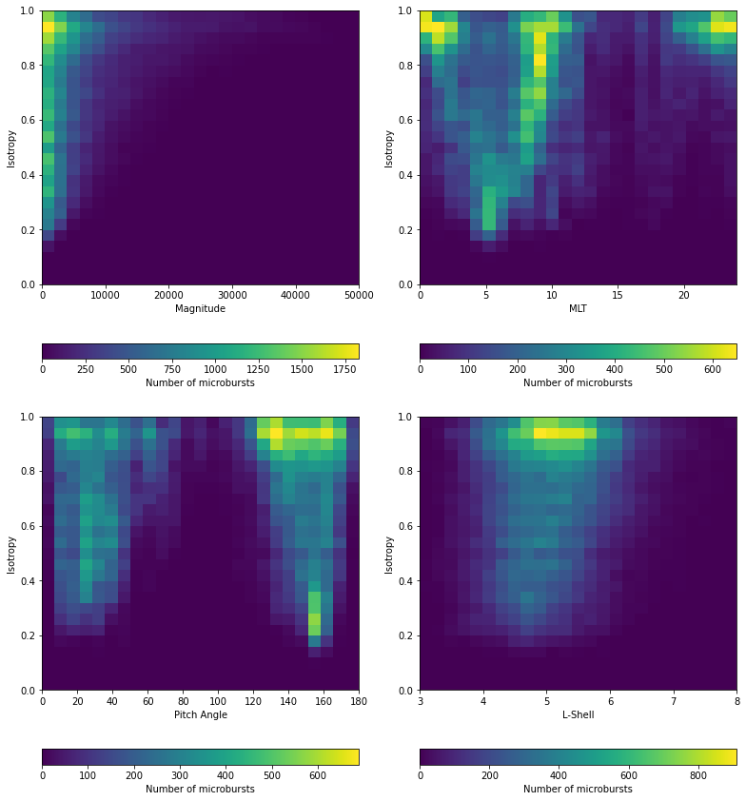
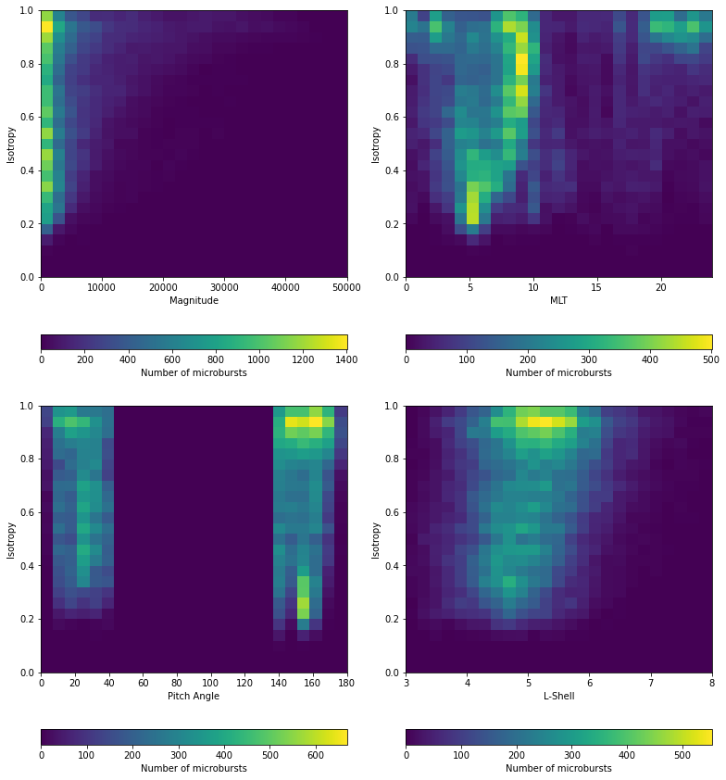
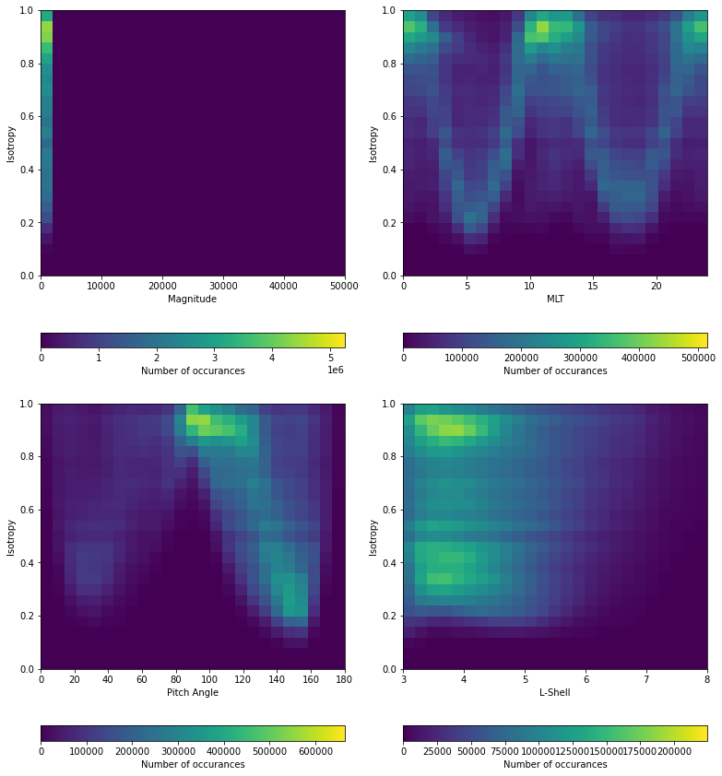
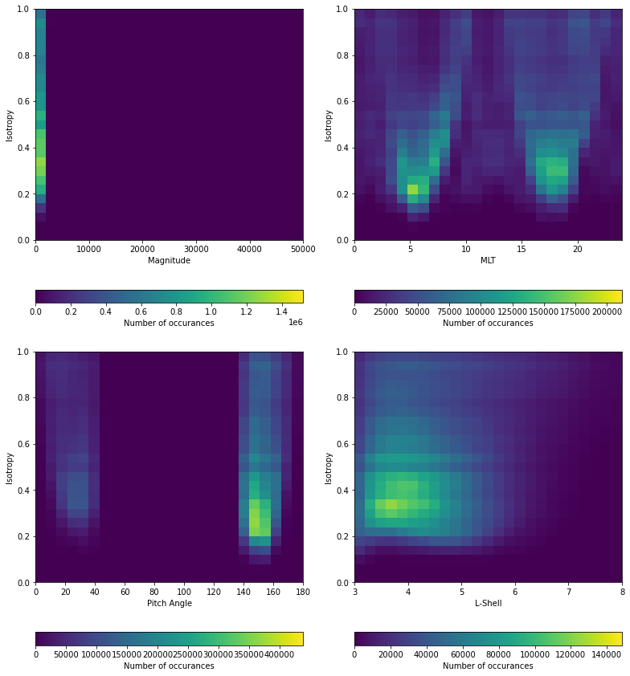
New Pitch Angle Mask (PA <= 40)
Old 2D Histograms: New 2D Histograms:
Microburst ->
Background ->

Slide 3
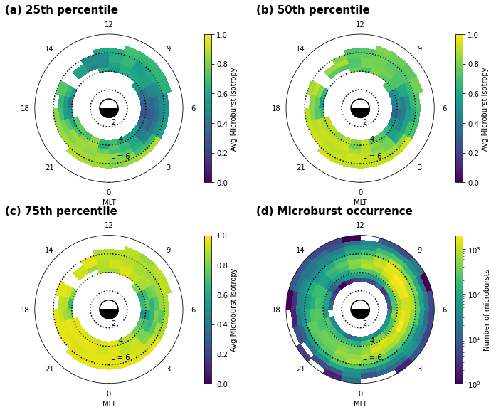
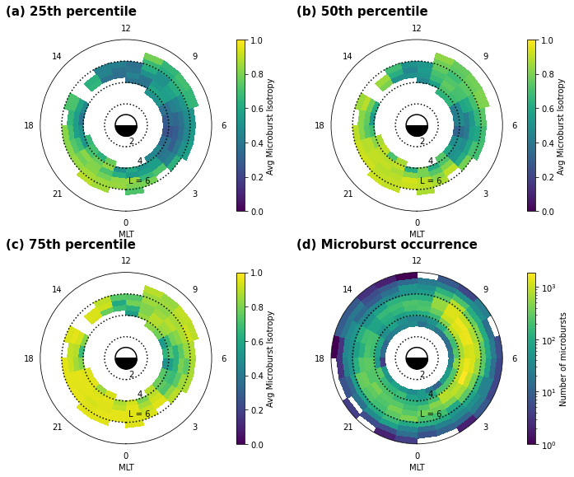
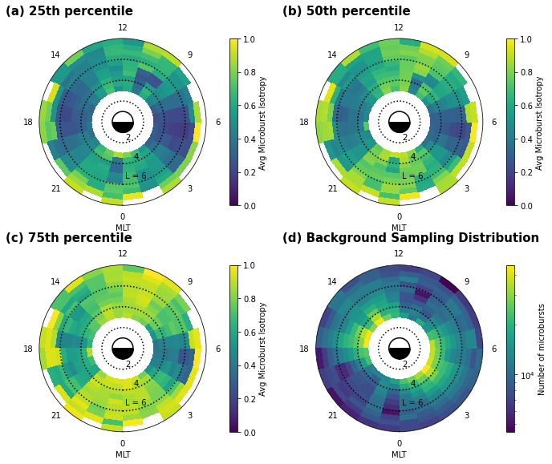
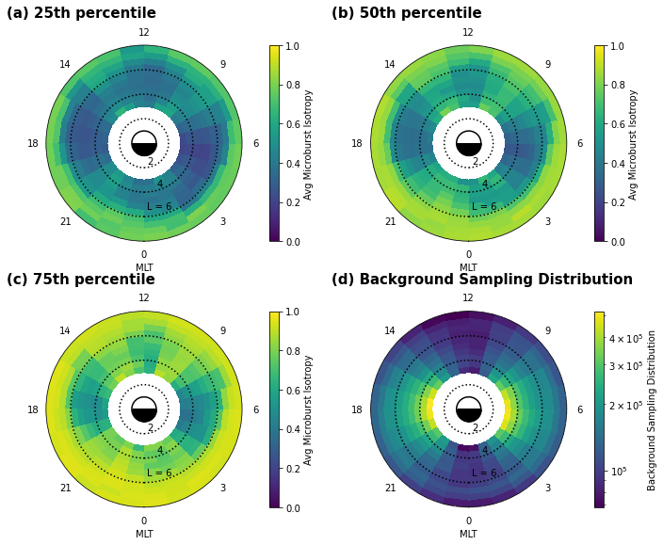
New Pitch Angle Mask (PA <= 40)
Old Dial Plots: New Dial Plots:
Microburst ->
Background ->

Slide 4
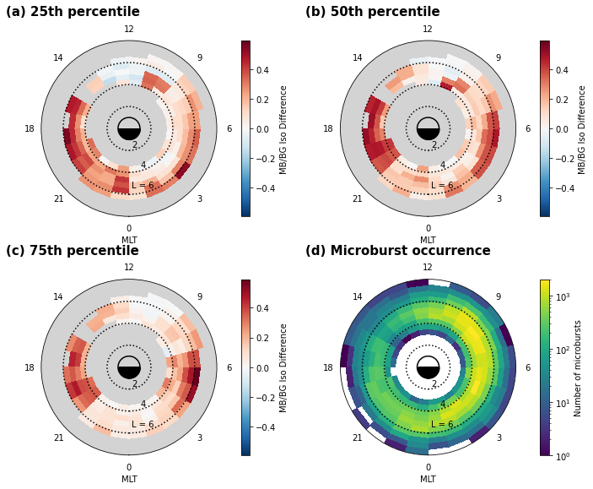
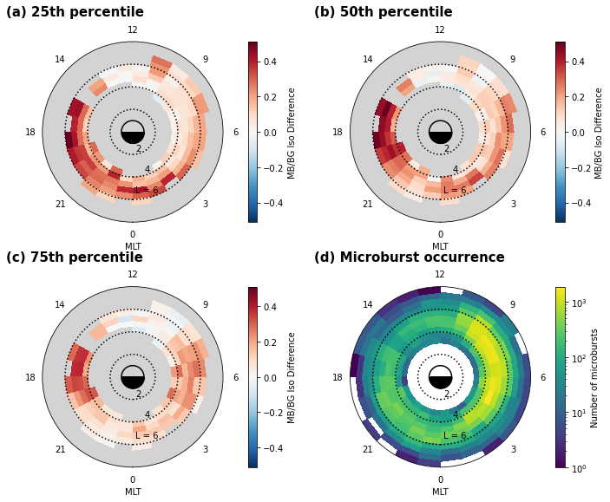
New Pitch Angle Mask (PA <= 40)
Did our results change significantly?
Old Dial Plots: New Dial Plots:

